Slide 1
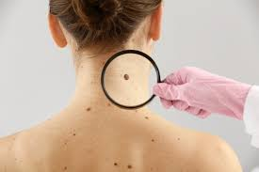
Melanoma
Fatima Al jojo M.D.
Medical Oncology

Slide 2
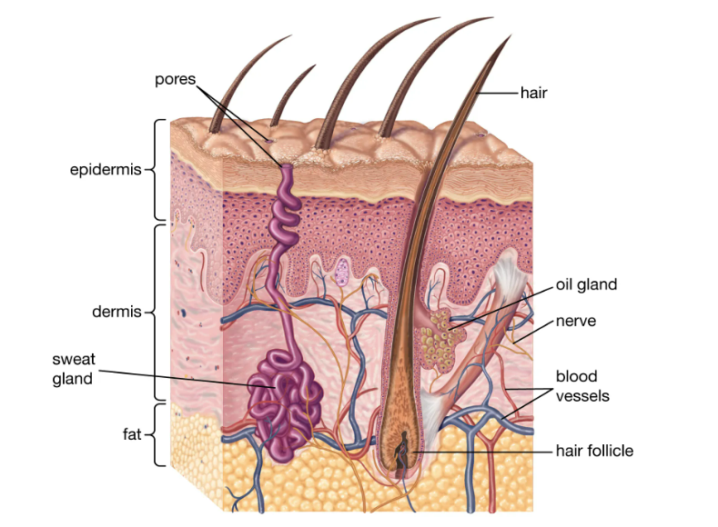

Melanoma incidence is increasing in men more rapidly than any other malignancy and in women more rapidly than any other malignancy except lung cancer
NCCN guidelines version 1.2022

Slide 3
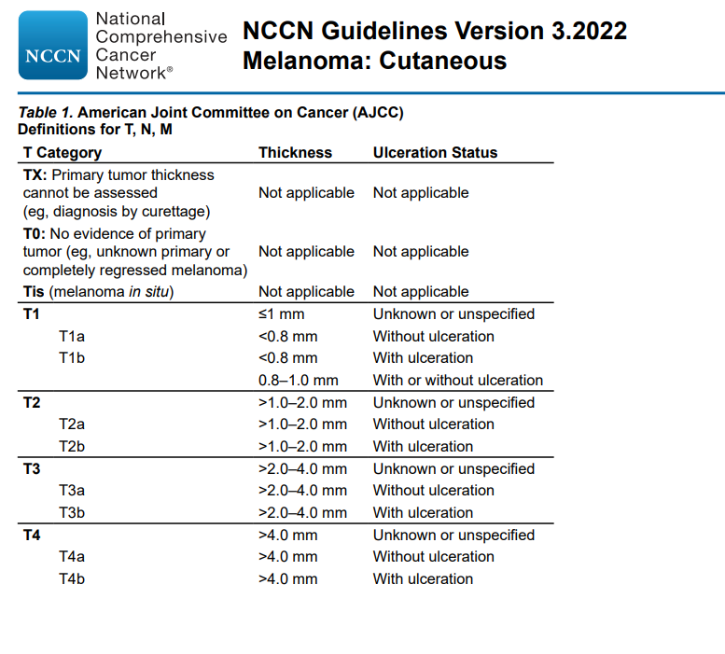
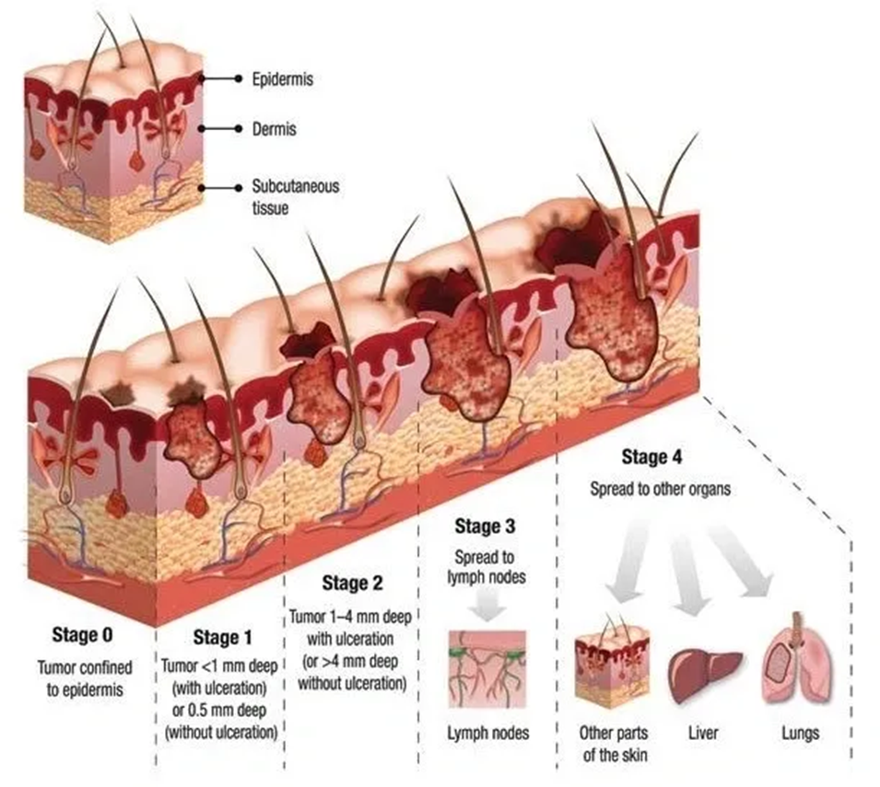

Slide 4
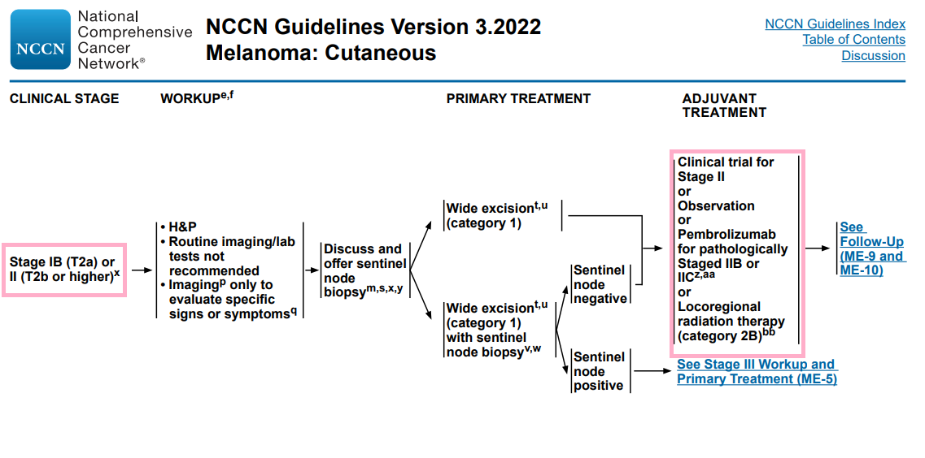

Slide 5
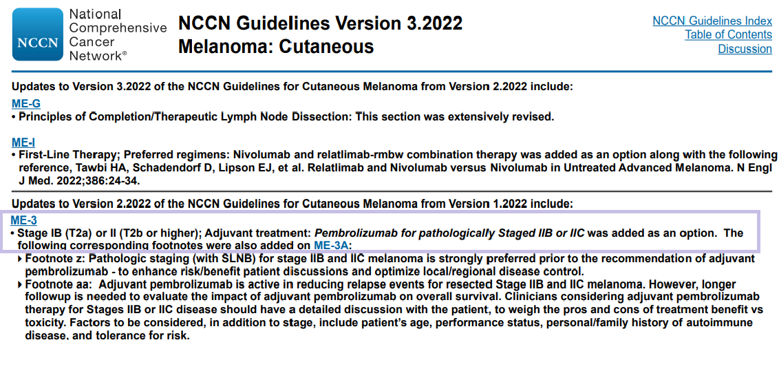

Slide 6
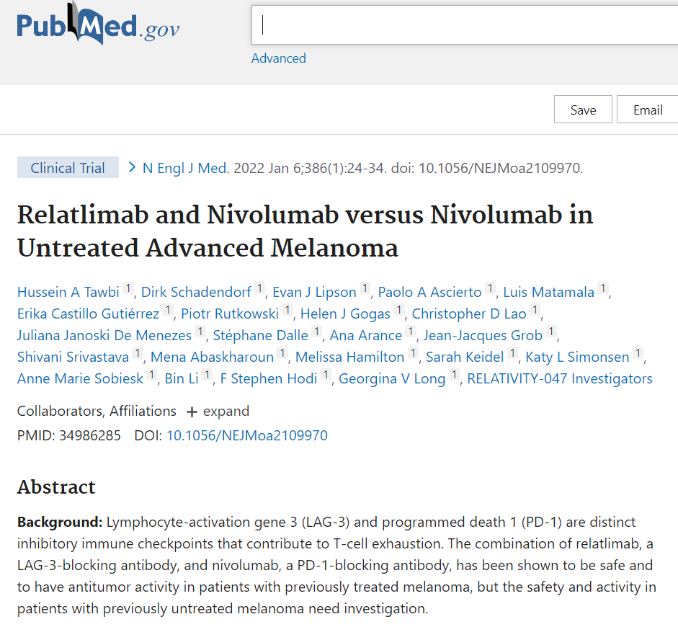
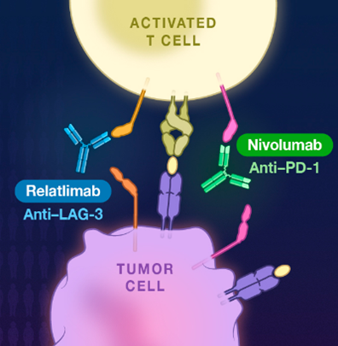

Slide 7
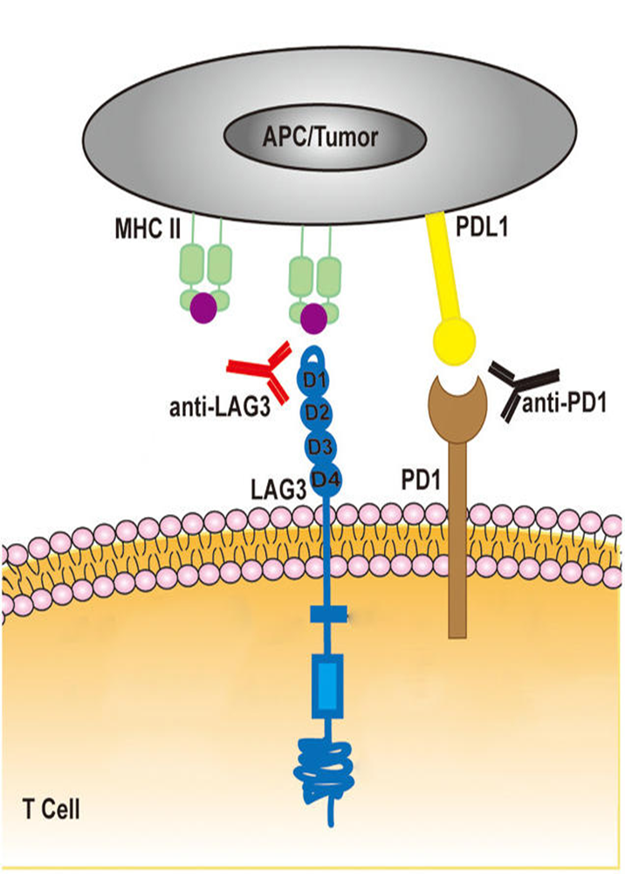
What is anti LAG3?
A monoclonal antibody targeting the co-inhibitory receptor lymphocyte-activation gene 3 protein (LAG-3; LAG3; CD223), with potential immune checkpoint inhibitory and antineoplastic activities

Slide 8
LAG-3 immunological functions
LAG-3 interacts with its ligands to regulate the function of T cells. The interaction between MHC II and LAG-3 can down-regulate the cytokine secretion level and proliferation ability of CD4+ T cells
The anti-LAG-3 antibody can restore CD4+ T cells activity

Slide 9
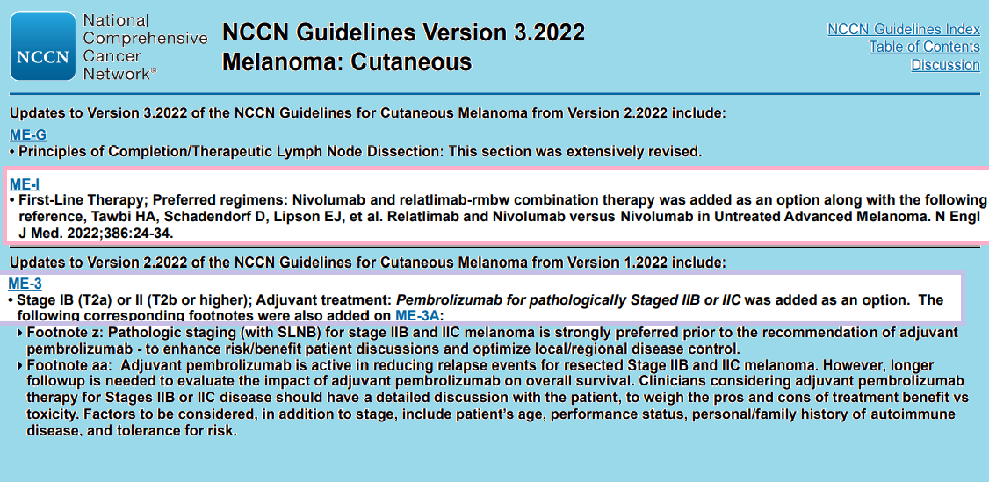

Slide 10
Systemic therapy for metastatic melanoma
BRAF/MEK inhibitors: for BRAF V600 mutation:
Dabrafenib/trametinib
Vemurafenib/cobimetinib
Oncorafenib/binimetinib

Slide 11
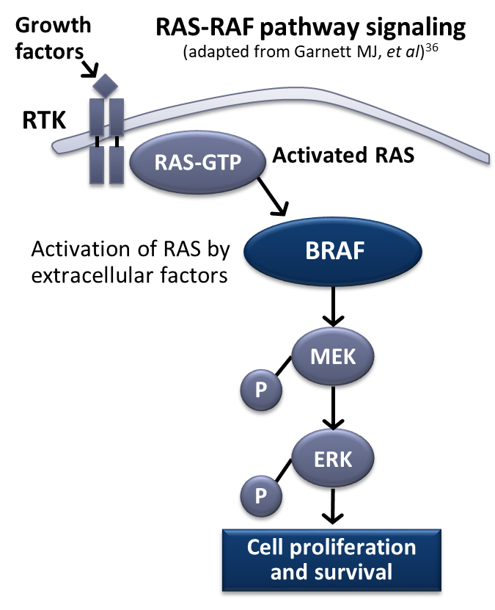
Systemic therapy for metastatic melanoma
BRAF/MEK inhibitors: for BRAF V600 mutation:
Dabrafenib/trametinib
Vemurafenib/cobimetinib
Oncorafenib/binimetinib
Mutations in malignant melanoma are often mutually exclusive
BRAF (50%), NRAS (13.25%), MEK1 (6%), KIT (2.6%), CTNNB1 (2%–3%), GNA11 (2%), or GNAQ (1%)

Slide 12
BRAF/MEK inhibitors for metastatic melanoma
BRAF/MEK inhibitor combination therapy was associated with improved response rate, PFS, and OS compared to BRAF inhibitor monotherapy, as well as a similar or better toxicity profile
If BRAF/MEK inhibitor combination is contraindicated, BRAF inhibitor monotherapy with vemurafenib or dabrafenib are recommended options, especially in patients who are not appropriate candidates for checkpoint immunotherapies
Patients treated with BRAF targeted therapy as first line therapy who achieved maximum clinical benefit (but not complete remission), a switch to immune check inhibitor may be considered
Notes:
Maximum clinical benefit: no additional tumor regression on at least 2 consecutive scans taken at least 12 weeks apart

Slide 13
Systemic therapy for metastatic melanoma
BRAF/MEK inhibitors: for BRAF V600 mutation:
Dabrafenib/trametinib
Vemurafenib/cobimetinib
Oncorafenib/binimetinib
Checkpoint inhibitors: effective regardless of BRAF mutation status
Anti PD-1: nivoluman, Pembrolizumab
Anti TCLA-4: ipilimumab

Slide 14
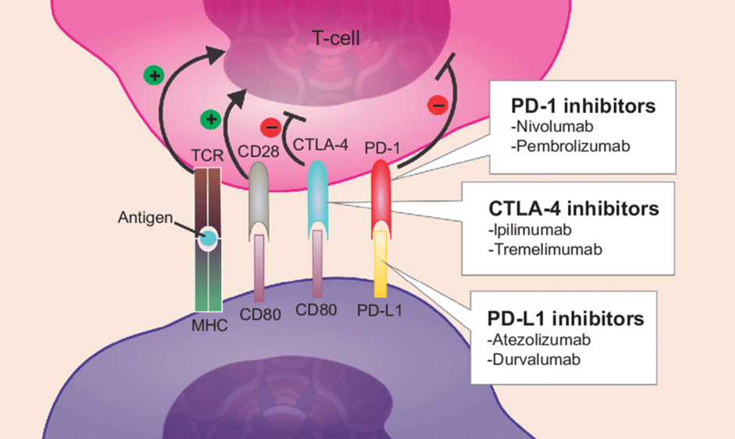
Systemic therapy for metastatic melanoma
Checkpoint inhibitors: effective regardless of BRAF mutation status
Anti PD-1: nivoluman, Pembrolizumab
Anti TCLA-4: ipilimumab

Slide 15
Systemic therapy for metastatic melanoma
BRAF/MEK inhibitors: for BRAF V600 mutation:
Dabrafenib/trametinib
Vemurafenib/cobimetinib
Oncorafenib/binimetinib
Checkpoint inhibitors: effective regardless of BRAF mutation status
Anti PD-1: nivoluman, Pembrolizumab
Anti TCLA-4: ipilimumab
Imatinib: for activating KIT mutations

Slide 16
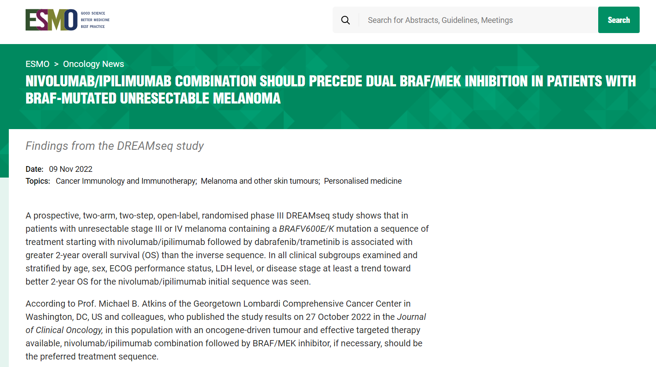

Slide 17
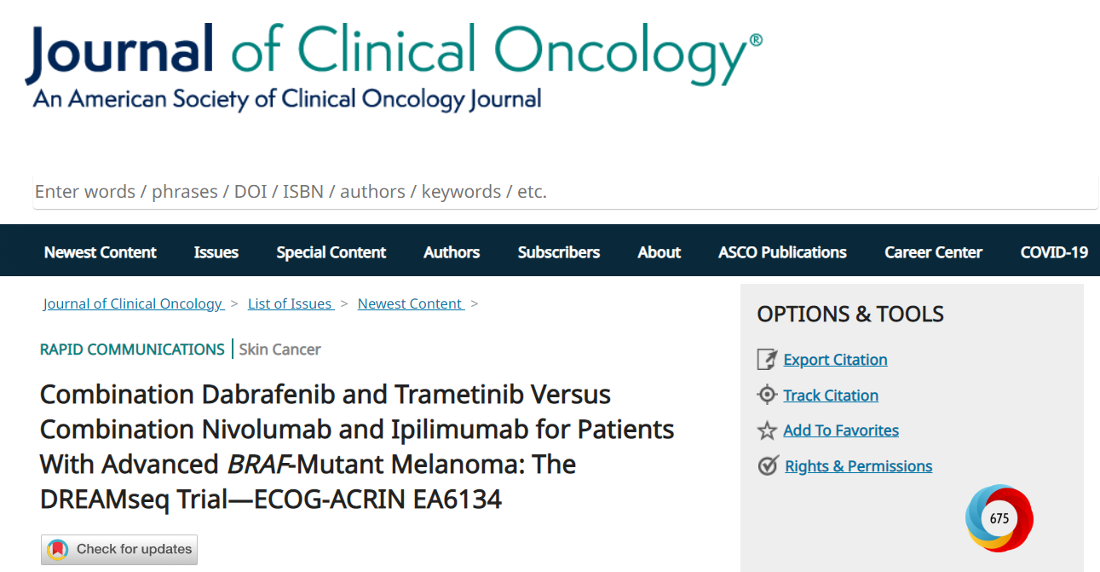

Slide 18
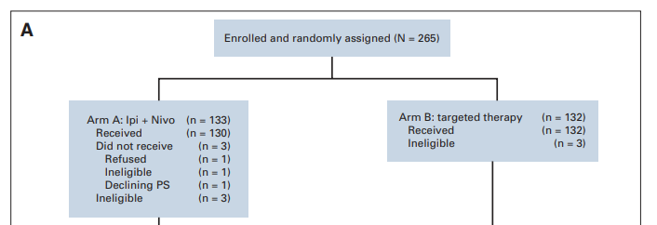
In a phase III trial, patients with treatment-naive BRAFV600-mutant metastatic melanoma were randomly assigned to receive either combination nivolumab/ipilimumab (arm A) or dabrafenib/trametinib (arm B) in step 1, and at disease progression were enrolled in step 2 to receive the alternate therapy, dabrafenib/trametinib (arm C) or nivolumab/ipilimumab (arm D).

Slide 19
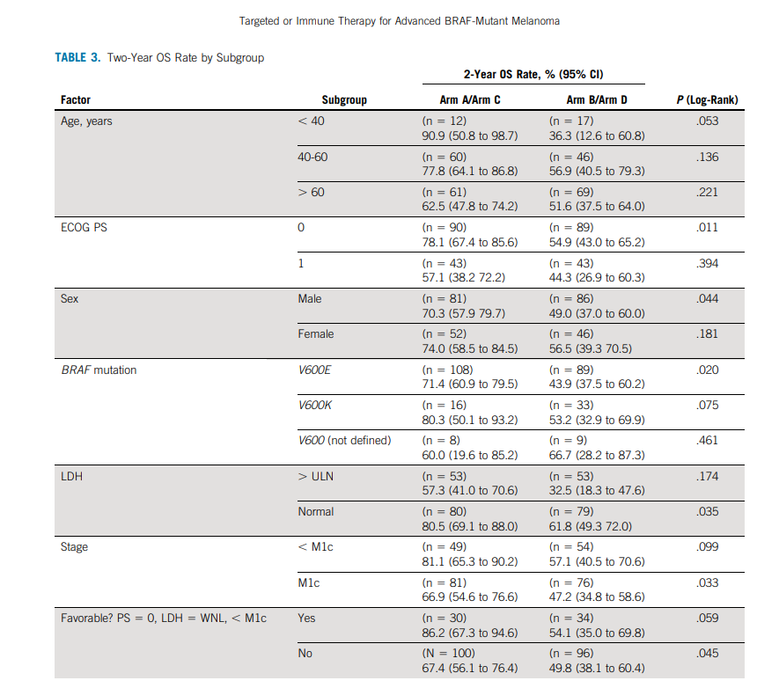
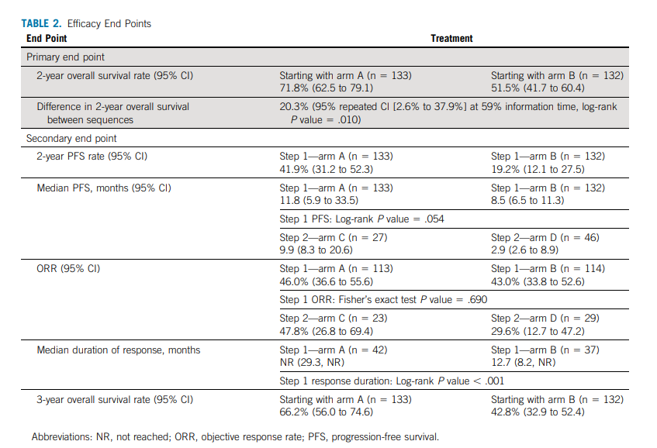

Slide 20
Secondary end points :
3-year OS
Response duration
Progression-free survival
Safety
The primary end point
2-year overall survival (OS).

Slide 21
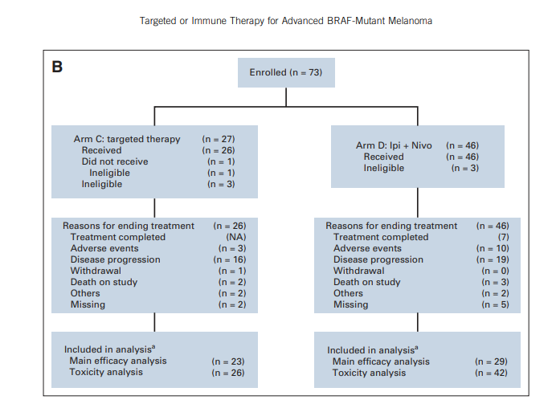

Slide 22
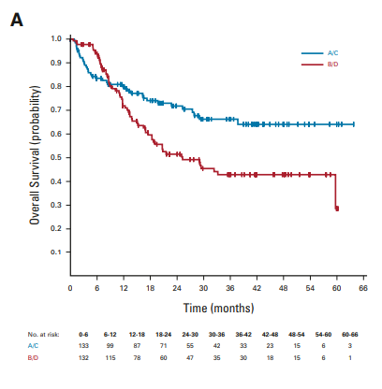
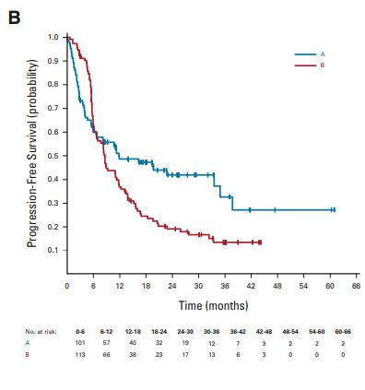
The study was stopped early by the independent Data Safety Monitoring Committee because of a clinically significant end point being achieved.

Slide 23
The 2-year OS
Arm A was 71.8% (95% CI, 62.5 to 79.1)
Arm B 51.5% (95% CI, 41.7 to 60.4; log-rank P = .010).
Step 1 progression-free survival favored arm A (P = .054).
Median duration of response was not reached for arm A and 12.7 months for arm B (P < .001).

Slide 25
CONCLUSION
Combination nivolumab/ipilimumab followed by BRAF and MEK inhibitor therapy, if necessary, should be the preferred treatment sequence for a large majority of patients.

Slide 26
The sequencing conclusions of this study may not apply to patients treated with other immunotherapy regimens or to patients who have received adjuvant anti-PD1, anti-CTLA4 or BRAF/MEK inhibitors.
The study was supported by the ECOG-ACRIN Cancer Research Group and by the US National Cancer Institute of the National Institutes of Health awards.
The study findings were previously presented at the inaugural ASCO Virtual Plenary Session on 16 November 2021 and in part on 5 June at the 2022 ASCO Annual Meeting in Chicago, IL, US

Slide 27

ف
Thank you

